Slide 1
A realtime chat Dapp(decentralized application) based on Web3.0 and Blockchain.

Slide 2
Problem Statement
The privacy issues in a time where digital life is almost consuming us is a grave threat.
➡Users have to submit sensitive data, like name, date of birth, and phone number.
➡Apps are often misused to spread fake news and misinformation.
➡Many messaging applications store the data on the cloud, which is not encrypted, exposing it to vulnerabilities.
➡Several apps use personal information for unethical purposes. They allegedly shared the data acquired with advertisers. To this date, cases of such privacy and data leaks have already happened.

Slide 3
We got a Solution!
The demand for private instant communication fueled the rise of encrypted messaging apps. So, in this project we are building a realtime chat Dapp(decentralized application) based on Web3.0 and Blockchain.

Slide 4
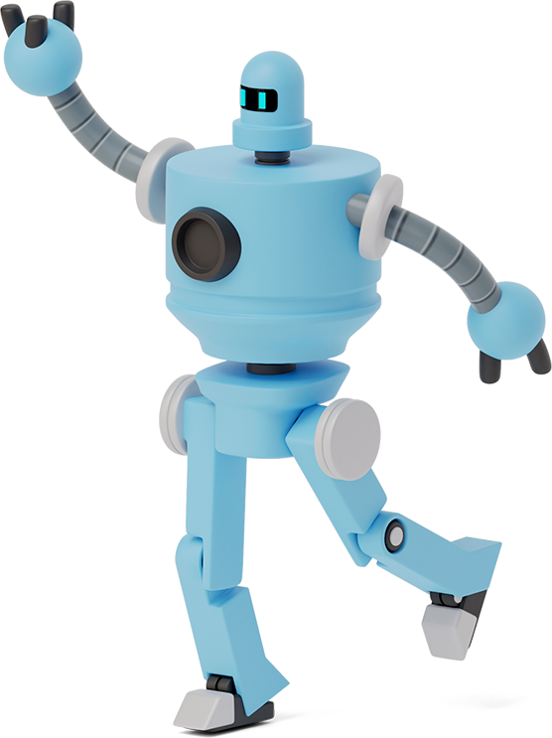
What problem does our web application solve?
A completely secure and anonymous sign-up, only needing a crypto wallet address. No need for names, IDs, or phone numbers (like Telegram). Total user privacy, without compromise.
No cloud storage, no user moderation, and complete end-to-end encryption for all messages between users – completely eliminating the risk of hacks or data leaks.
All messaging history and files are on anonymous, independent, and non-connected nodes, on the Blockchain network. This eliminates all points of failure and, as it grows and expands its nodes, becomes increasingly secure.

Slide 5
Future Scope
The goal of this project was to analyze inefficiencies of the traditional central based messaging applications and address them by using Ethereum smart contracts in trustless and secure decentralized application. This has been achieved by developing a decentralized application that can be run by any user to send and receive encrypted messages. Adding capabilities like picture and video sharing, customized chat groups and exploring a new technology in blockchain called Whisper for messaging are some of the future directions.

Slide 6
Conclusion
In this project, we are developing an application that makes use of blockchain in a very efficient way.
Also, by eliminating the centralized approach, we can assure the safety and availability of data and communication. Decentralized applications tend to make the interaction between two people more efficient and simpler.
The chatting process nowadays has a mediating node, while our software does not have any mediating device/node i.e., every person is connected by peer-to-peer network.

Slide 7
THANKS!
For the wonderful opportunity to explore the world of Blockchain Technology.

